Slide 1
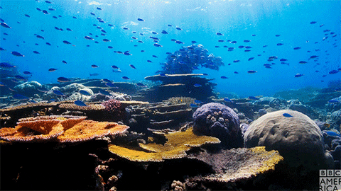


Comparative geomorphology of coral reefs from a joint analysis of ICESat-2 bathymetry and multi-spectral imagery using machine learning
Karan Sunil, Adrian Borsa
University of California San Diego
Notes:
UCSD Undergrad
NASA ICESAT-2
European Space Agency Sentinel-2

Slide 2
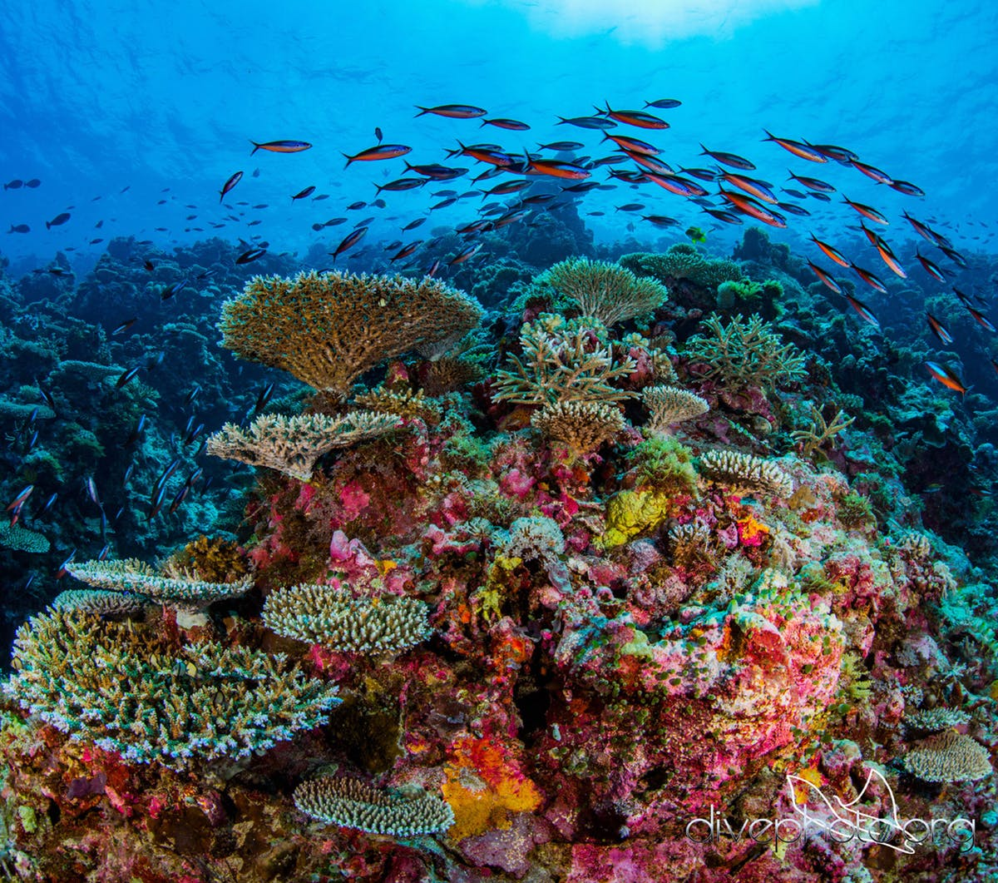
Introduction to coral reefs
Covers 1% of the Earth’s surface.
Supports the most species per unit area for marine ecosystems.
Take between 100,000 to 30,000,000 years to fully form.
Generates $375 billion each year through tourism.
Numerous drugs developed from coral reef animals and plants.

Slide 3
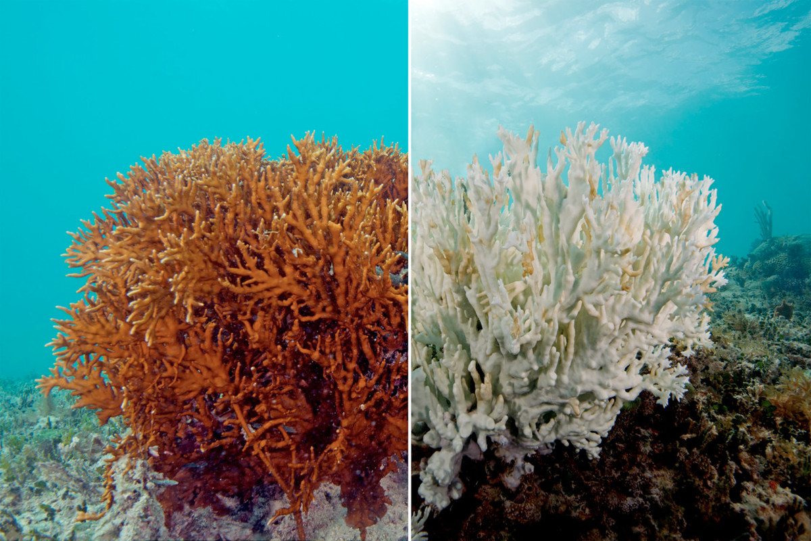
Threats to coral reefs
Weather related damages – cyclones, hurricanes.
Long periods of exceptionally low tides.
Increased sea surface temperatures.
Pollution – increases nutrient level that leads to higher algae growth.
Overfishing.
Healthy coral
Bleached coral
Notes:
Bleaching – happens in shallow waters

Slide 4
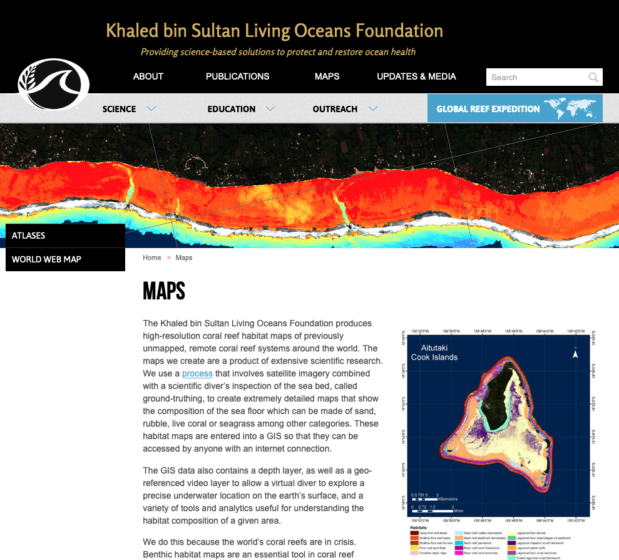
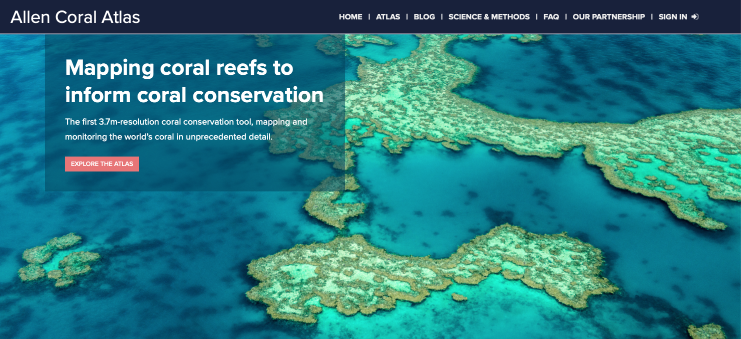
Coral reef mapping
Currently there are two global coral reef mapping projects: the Allen Coral Atlas, and the Khaled bin Sultan Living Oceans Foundation.
They map depths using satellite imagery that is validated by sonar/lidar. This process is expensive and time-consuming.
Notes:
Allen Coral Atlas
Living Oceans Foundation

Slide 5

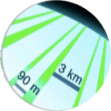
NASA’s ICESat-2 Mission
ICESat-2 is a satellite laser altimeter making repeated observations of ice/land/ocean elevations globally.
ICESat-2’s blue-green laser penetrates water and measures shallow water bathymetry to decimeter accuracy.
Our goal – use ICESat-2 data as “ground truth” for estimation of coral reef bathymetry.
ICESat-2 projects six laser beams, separated by 90 m to 3 km.
Each beam can provide independent ground truth over a reef.
Notes:
Mission (measure heights of ice sheets and sea ice)
Our goal
How calculated
Laser
Orbits

Slide 6
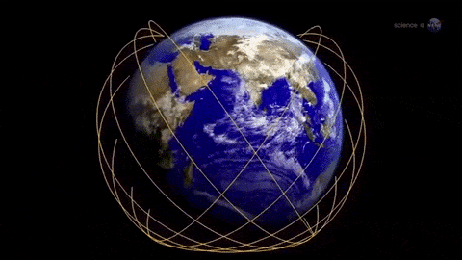
NASA’s ICESat-2 Mission
ICESat-2 is a satellite laser altimeter making repeated observations of ice/land/ocean elevations globally.
ICESat-2’s blue-green laser penetrates water and measures shallow water bathymetry to decimeter accuracy.
Our goal – use ICESat-2 data as “ground truth” for estimation of coral reef bathymetry.
ICESat-2 projects six laser beams, separated by 90 m to 3 km.
Each beam can provide independent ground truth over a reef.
ICESat-2 orbits Earth 15 times daily…
Notes:
Mission (measure heights of ice sheets and sea ice)
Our goal
How calculated
Laser
Orbits

Slide 7
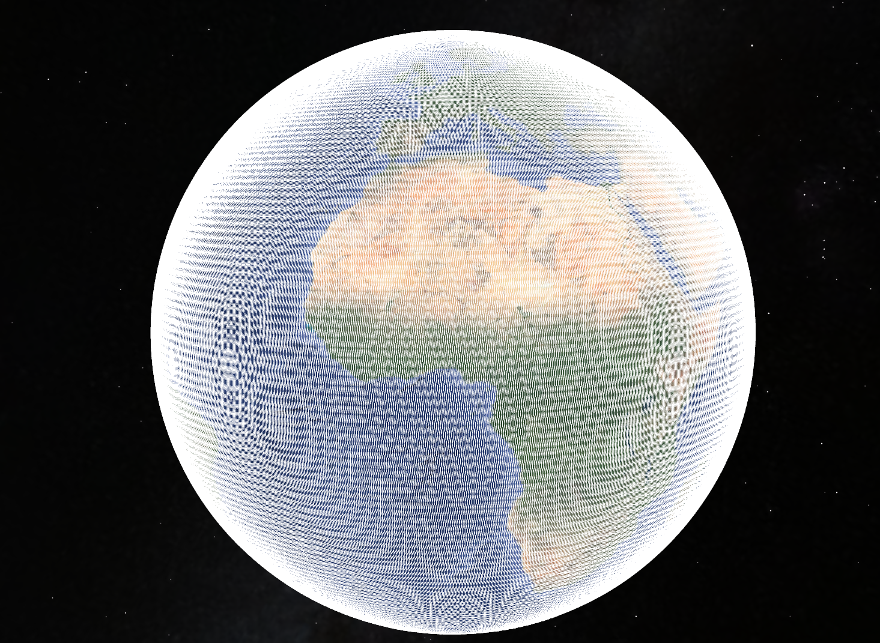
NASA’s ICESat-2 Mission
ICESat-2 is a satellite laser altimeter making repeated observations of ice/land/ocean elevations globally.
ICESat-2’s blue-green laser penetrates water and measures shallow water bathymetry to decimeter accuracy.
Our goal – use ICESat-2 data as “ground truth” for estimation of coral reef bathymetry.
ICESat-2 projects six laser beams, separated by 90 m to 3 km.
Each beam can provide independent ground truth over a reef.
ICESat-2 orbits Earth 15 times daily… covering 1387 different ground tracks over
3 months before starting over.
Notes:
Mission (measure heights of ice sheets and sea ice)
Our goal
How calculated
Laser
Orbits

Slide 8
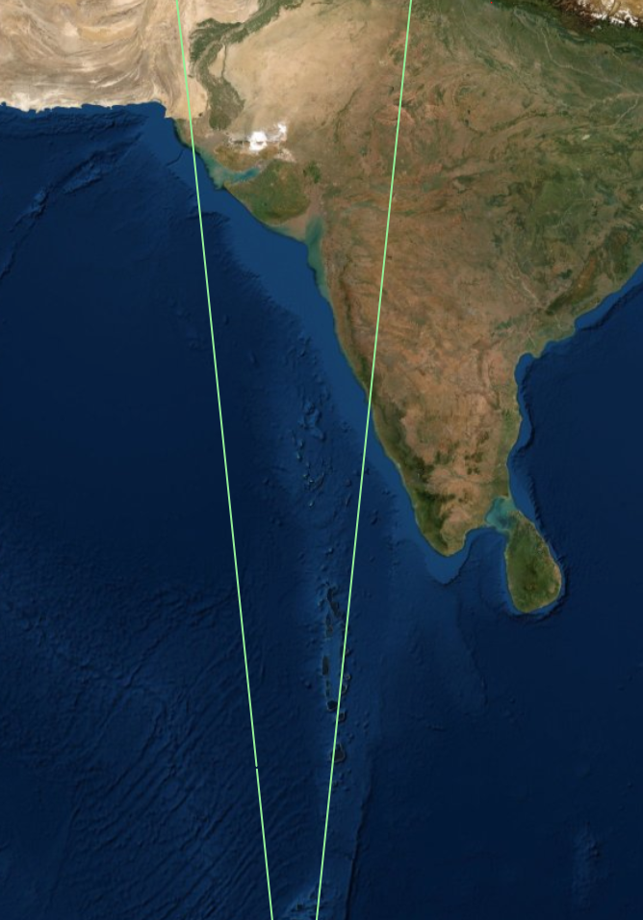
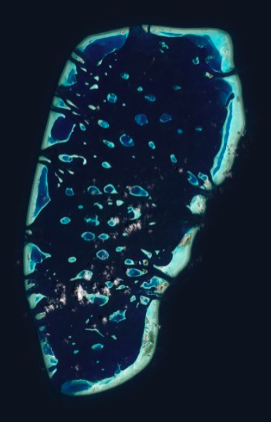
ICESat-2 bathymetry profile example (Dhiffushi, Maldives)
India
Track 508
Maldives

Slide 9
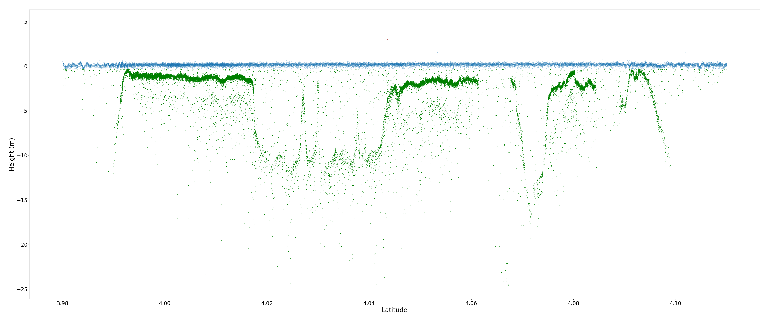
ICESat-2 bathymetry profile example (Dhiffushi, Maldives)
Classify individual ICESat-2 photons as reef or ocean
photons classified as ocean surface
photons classified as reef
Track 508, Beam gt1l, 2018-10-31
1 km

Slide 10
Methodology
Iterate from left to right through reef using rolling window.
Area of rolling window = 55m²
Track 508, Beam gt1l, 2018-10-31
Notes:
Iterate through the grid

Slide 11

Use Interquartile range and median to generate
one representative point for each window.
Filtered results to include just back to back predictions
Track 508, Beam gt1l, 2018-10-31

Slide 12
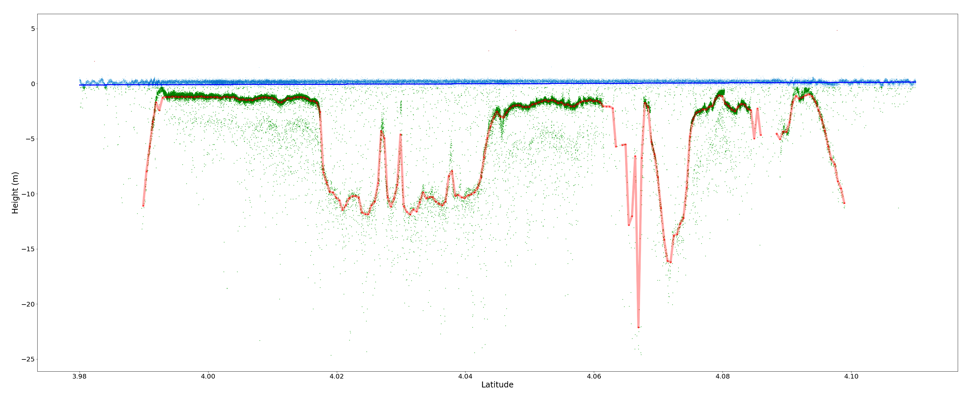
ICESat-2 bathymetry profile example (Dhiffushi, Maldives)
Profile generation: Bathymetry profile created by interpolation, correcting for refraction and referencing to mean sea level using independent tide estimates.
Track 508, Beam gt1l, 2018-10-31
Output is a profile of bathymetry estimates at uniform interval, with reduced noise, but also with errors

Slide 13
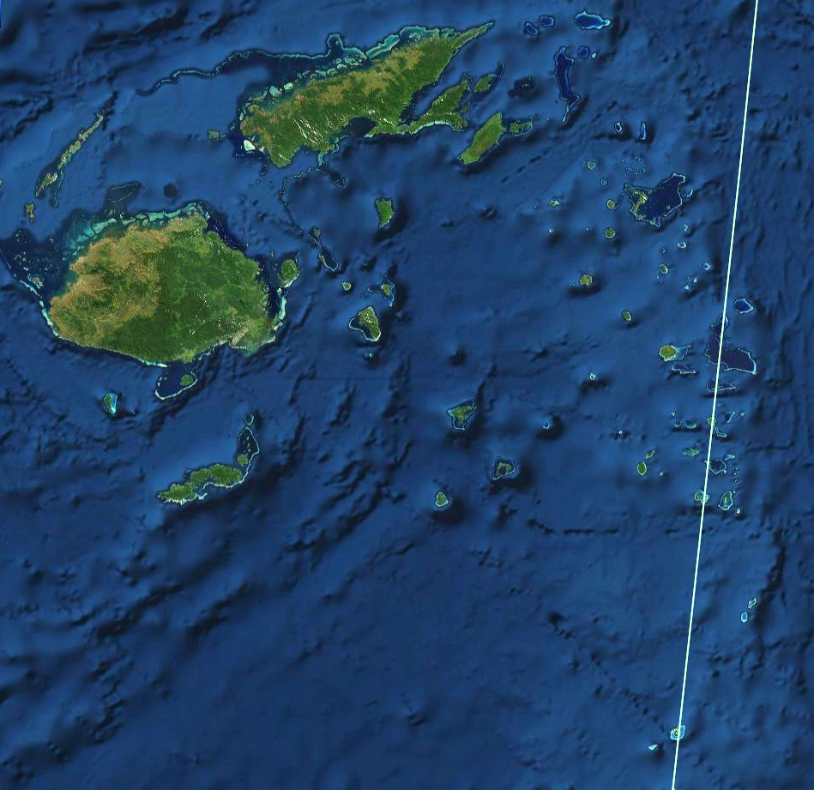
Track 1113
Bathymetry estimation for two atolls in Fiji, both located on ICESat-2 track 1113
Fiji
Moce
Oni-i-Lau

Slide 14
Track 1113
Fiji
Moce
Moce
Oni-i-Lau

Slide 15
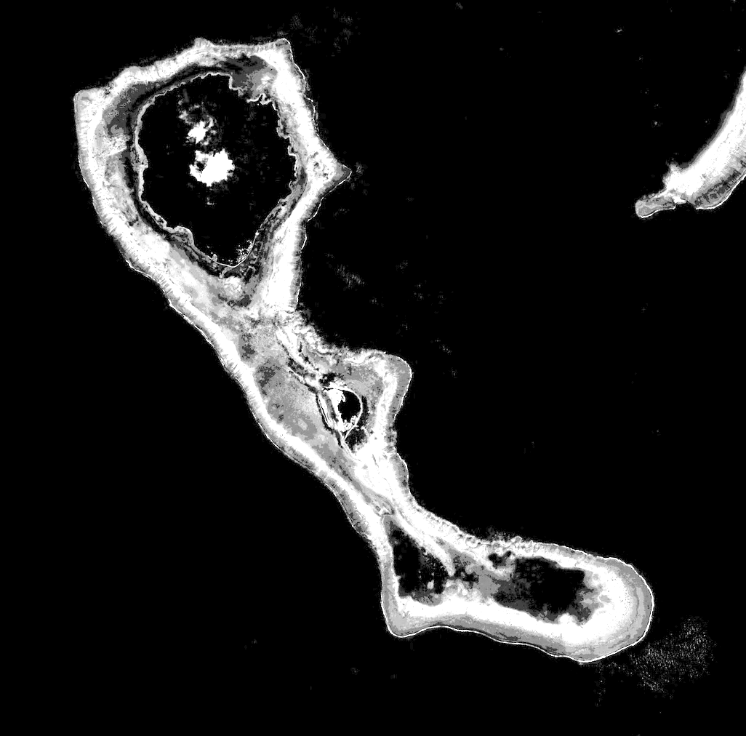
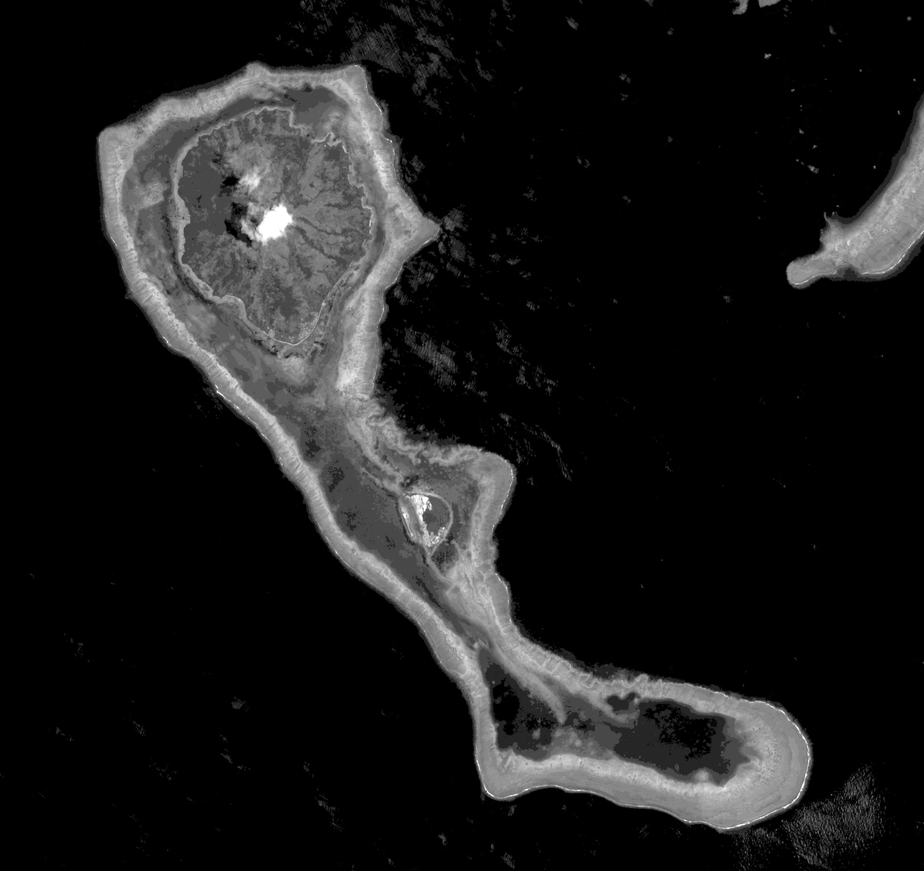
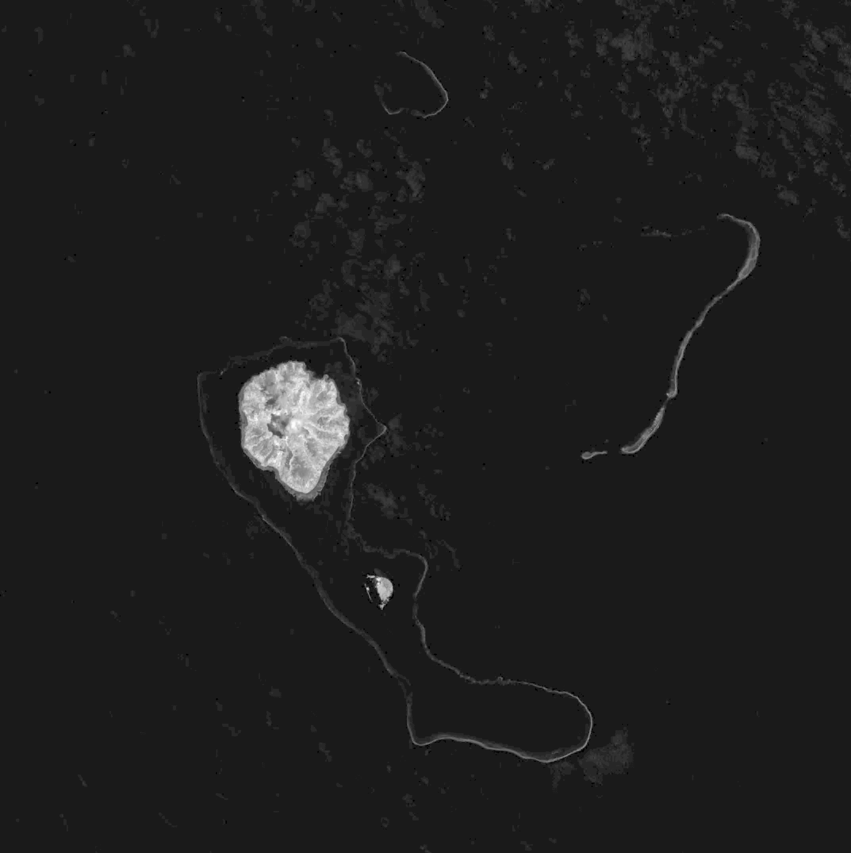
Sentinel-2 Multispectral Imagery (Moce, Fiji)
10-meter resolution
Global coverage
Freely/publicly available
Band 2 – Blue (0.490 μm)
Band 3 – Green (0.560 μm)
Band 8 – Near Infrared (0.842 μm)
Penetrates water, low attenuation with depth.
Penetrates water, moderate attenuation with depth.
High reflectance from clouds/land, no water penetration.

Slide 16
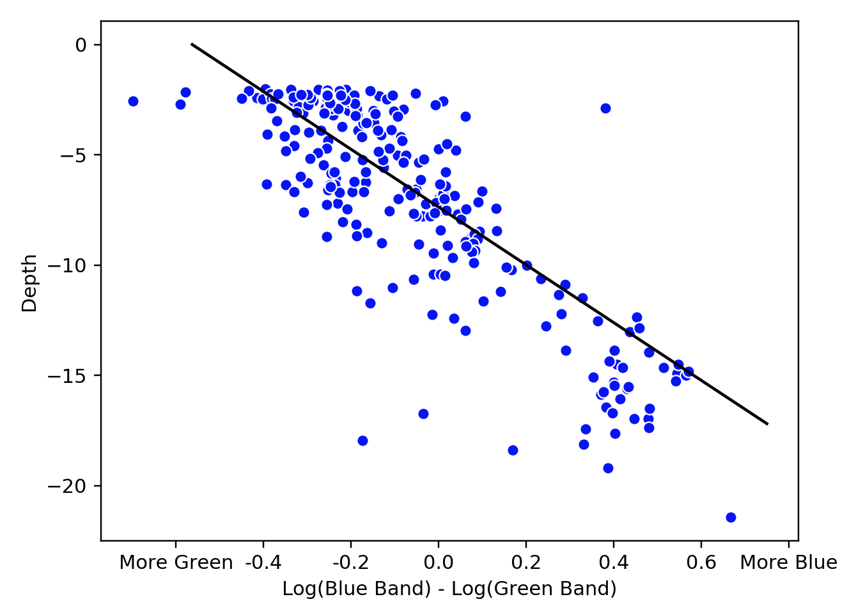
Bathymetry from imagery
Blue and green light that reflects from the seafloor is attenuated to different degrees by passage through seawater.
Can use the linear relationship between [Log(blue light) – Log(green light)] to estimate depth from Sentinel-2 green and blue pixel values.
Poor performance of imagery-only bathymetry estimates necessitates using independent bathymetry data to calibrate this relationship.
Figure at right shows actual data over Moce using depths from an ICESat-2 profile and collocated Sentinel-2 pixels.
2m buffer for sea level prediction

Slide 17
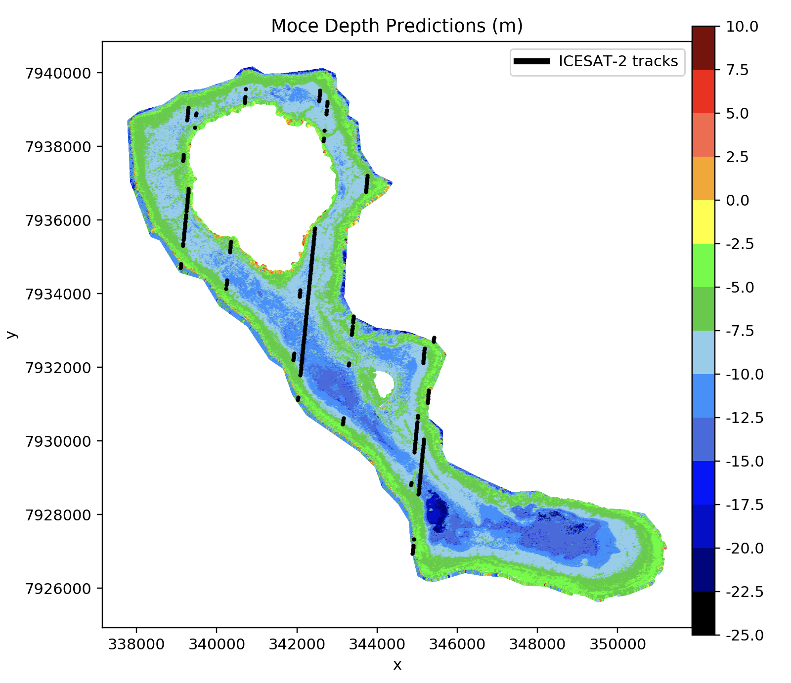
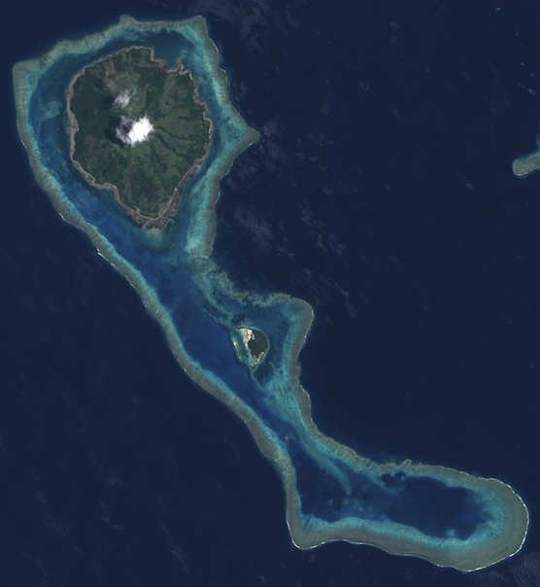
Moce, Fiji
L = Land
L
L

Slide 18
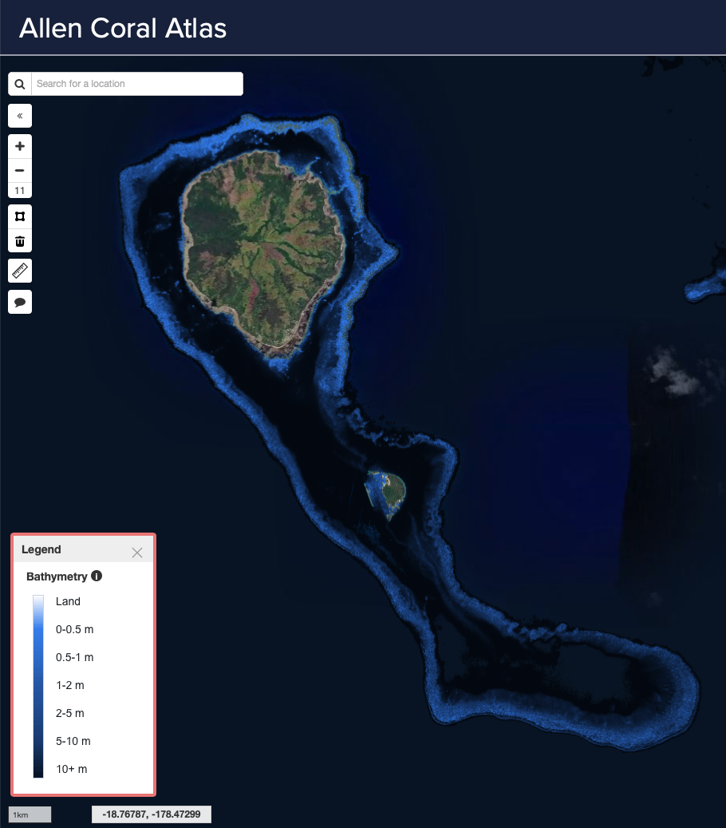
Moce, Fiji
L = Land
L
L
Bathymetry estimates from Allen Coral Atlas do not capture shallow/deep variations inside the atoll.

Slide 19

Track 1113
Fiji
Oni-i-Lau
Moce
Oni-i-Lau

Slide 20
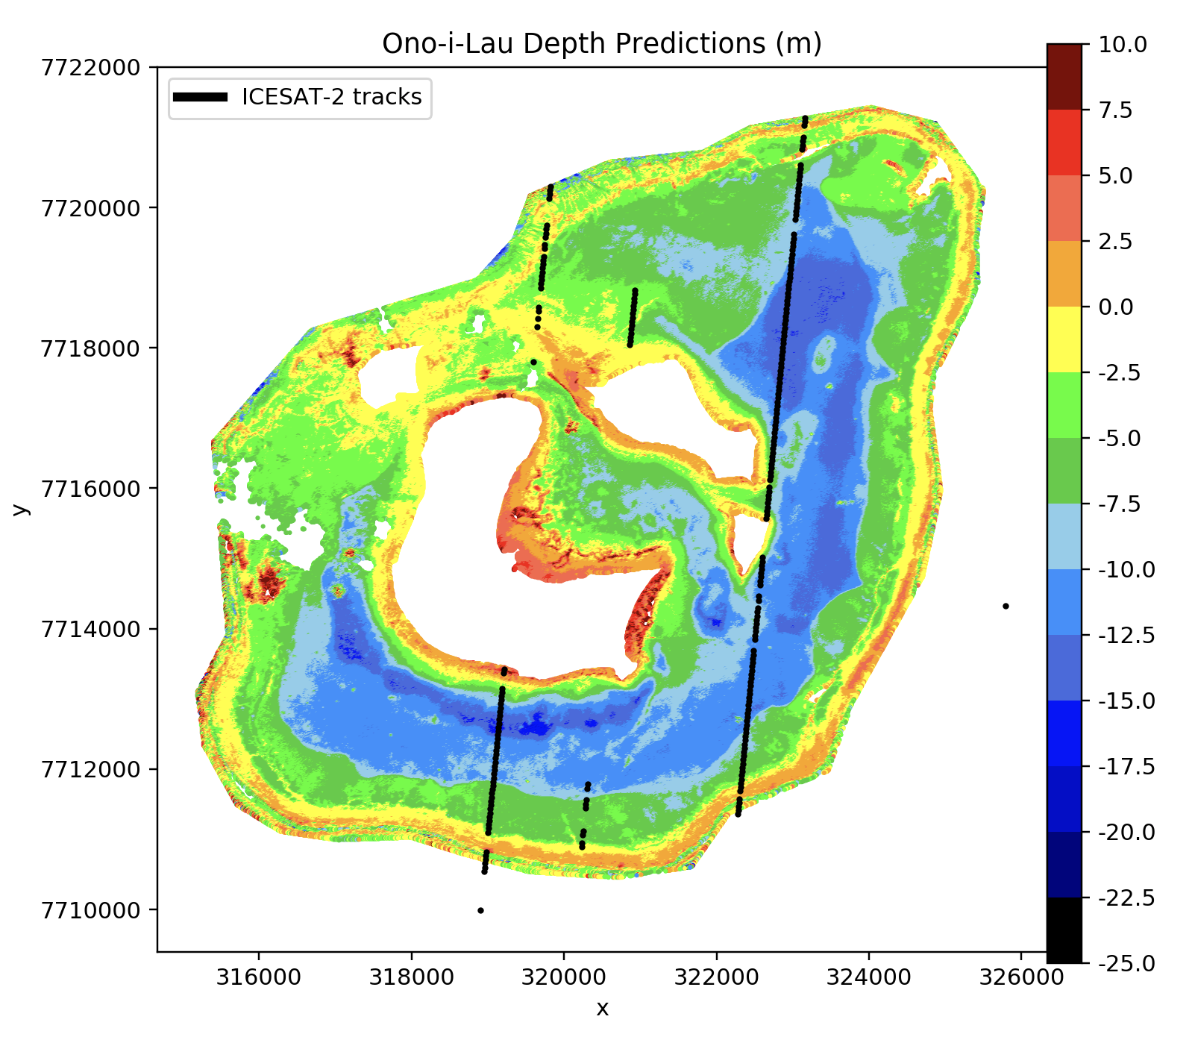
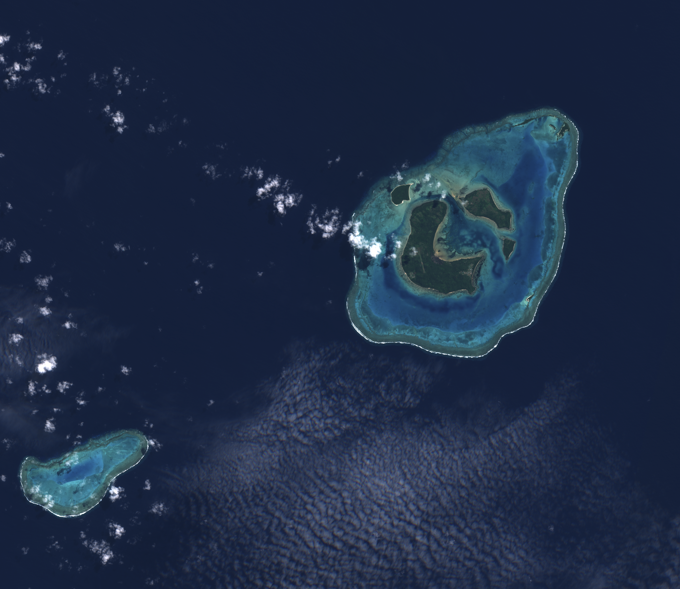
Ono-i-Lau, Fiji
L
L
C
L
L
L = Land
C = Clouds
Comparison of imagery with bathymetry estimate (right) indicates that the bathymetry is biased high, so that shallow reef is assigned positive elevations. Averaging multiple estimates reduces errors such as these.

Slide 21
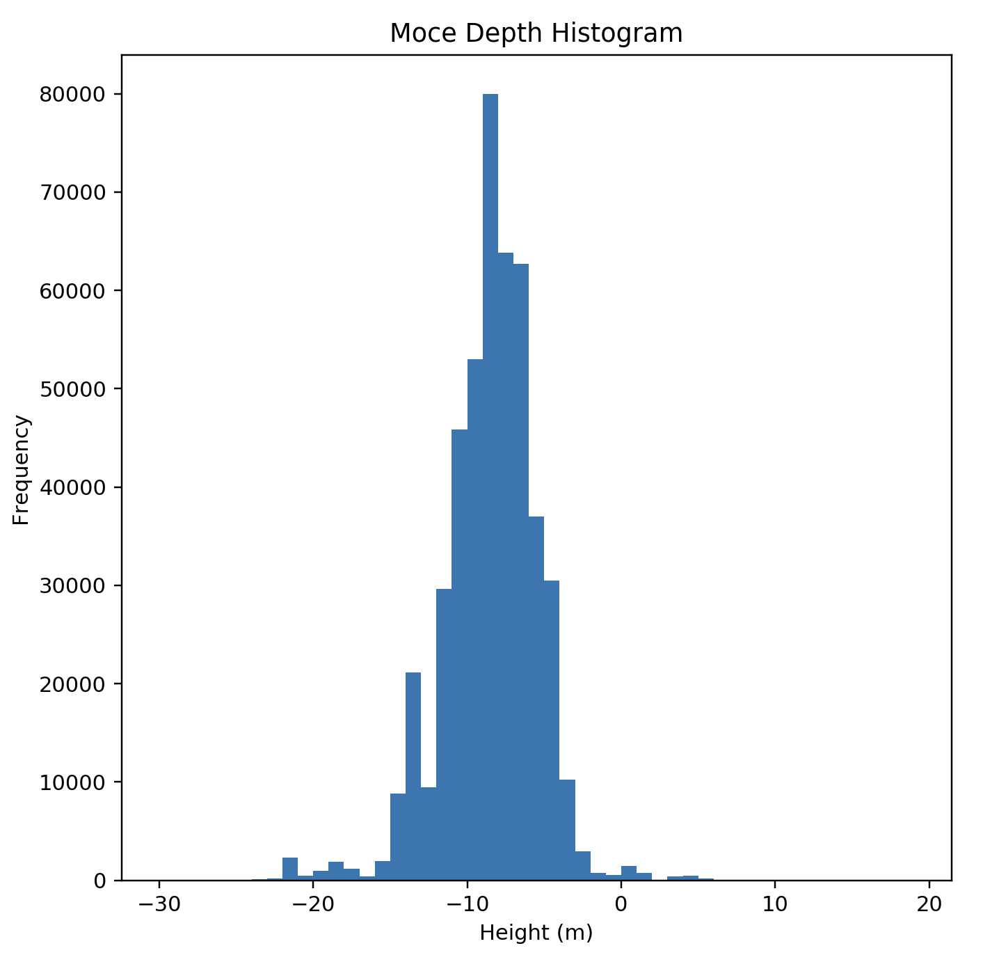
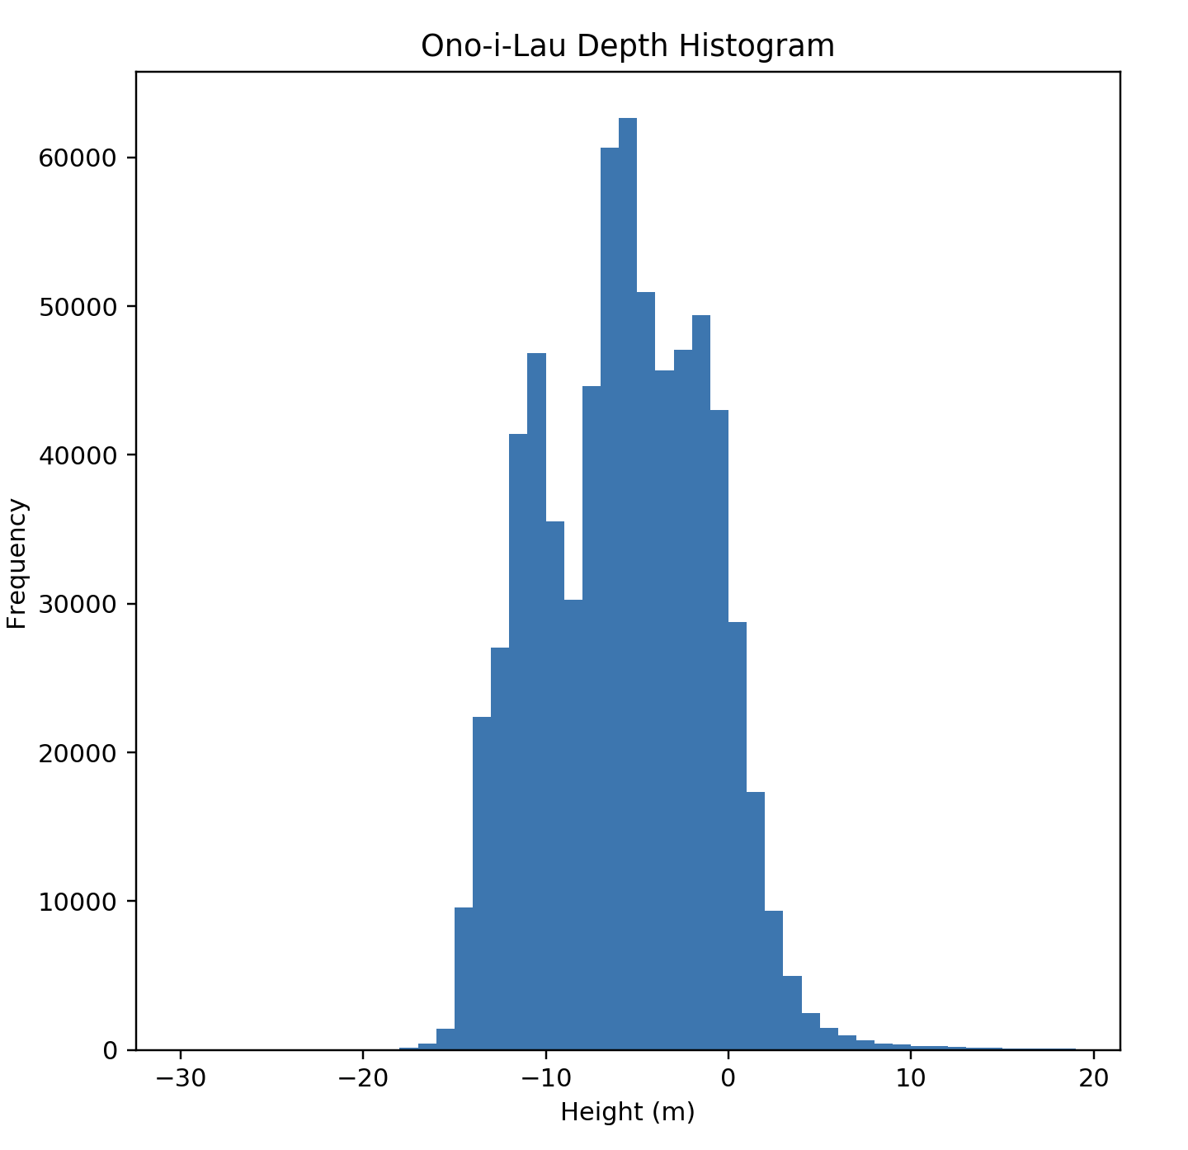
Bathymetry histograms of two Fiji reefs
Oni-i-Lau exhibits three peaks in its bathymetry distribution (labelled in yellow as Peaks 1-3), all separated by ~5 m.
Moce exhibits only two peaks, but these are also separated by ~5 m and may align with Oni-i-Lau peaks after estimates are averaged.
Peak 1
Peak 3
Peak 2

Slide 22
Conclusions
We can estimate coral reef bathymetry anywhere on Earth using a combination of satellite imagery and satellite bathymetry.
ICESat-2 photon data provide shallow bathymetry at 1-meter horizonal resolution, while satellite Imagery is at a 10m resolution suggesting that we can use higher-resolution imagery for bathymetric estimates
Applications:
From reef depth distributions, we can identify which corals are at a higher risk of endangerment due to sea surface warming.
We can study the effect of natural disasters such as hurricanes by analyzing before and after bathymetry.

